Slide 1
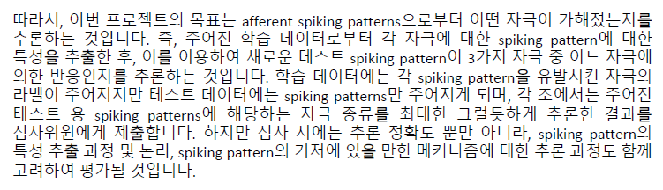
어제 이 시각…
데이터 과학의 관점
높은 분류 (classification) 정확도 얻기
Spiking pattern의 통계적으로 중요한 특징은 무엇일까?
신경생리학적 관점
화학 자극이 신경에 어떻게 작용하면 주어진 것과 같은 spiking pattern이 발생할 수 있을까?
Final goal: 주어진 신경 활동을 더 잘 이해하기

Slide 2
Result

Slide 3
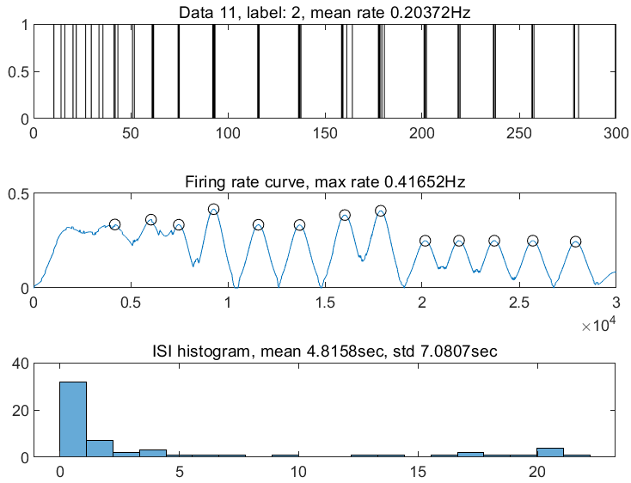
Statistical Modeling
Feature extraction
Every possible features / statistics that may imply the distinct properties of a spike train, such as overall firing rate, and especially clustering of spikes
FEATURE LIST
1. Mean firing rate (Hz)
* Smoothened firing rate curve
2. Max firing rate (Hz)
3. Peak intensity mean (Hz)
4. Peak intensity s.d. (Hz)
5. Peak interval (s)
6. Number of peaks
* Inter-spike interval statistics
7. ISI Mean (s)
8. ISI STD (s)
* Spikelet statistics
9. Spikelet regularity mean
10. Spikelet regularity s.d.
11. Spikelet length mean (s)
12. Spikelet length s.d. (s)
* Transient / decaying response
13. Mean firing rate (~80s)
14. Mean firing rate (80~190s)
15. Mean firing rate (190s~)
Cluster

Slide 4
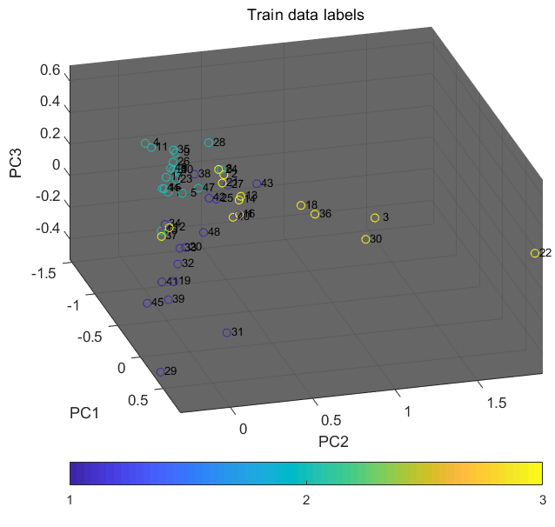
Statistical Modeling
Feature extraction
Nice segregation in principal component space!

Slide 5
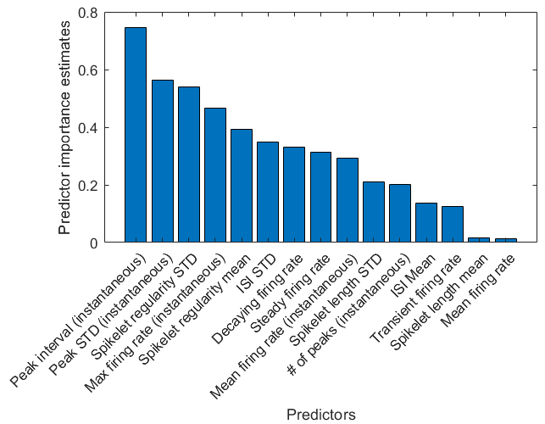
Statistical Modeling
Supervised learning model: Random forest / 5-fold CV error 17%
Why random forest?
Robust, reduces overfitting
After learning, we can trace back to relative importance of each feature in classification
Features representing overall spike distribution
Features representing cluster-related statistics
In the random forest machine, the properties of spike clustering are important for classifying spike train into class 1, 2, 3.
Is nociceptive stimulus information temporal-coded, or rate-coded?

Slide 6
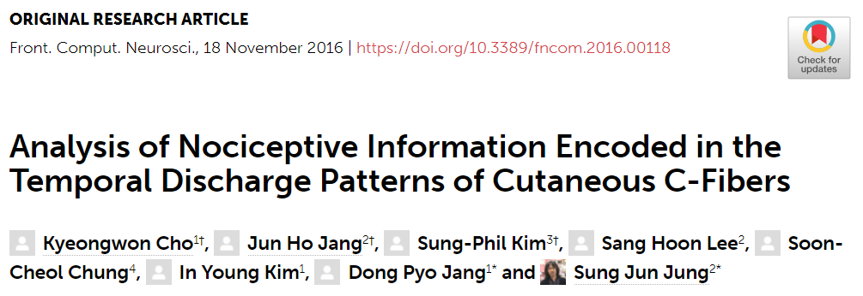
Neurophysiological support for our analysis
Our beloved paper…
“…some studies have reported the lack of a pain response to activation of C-fibers, whereas others have reported an increased pain response even without an increase in the discharge rate of the C-fibers (Van Hees and Gybels, 1981; Prescott et al., 2014).
…We demonstrated that nociceptive behavior was related to the temporal encoding of spike trains in primary afferent C-fibers, in which specific temporal patterns were generated according to the type of activated receptors.”

Slide 7
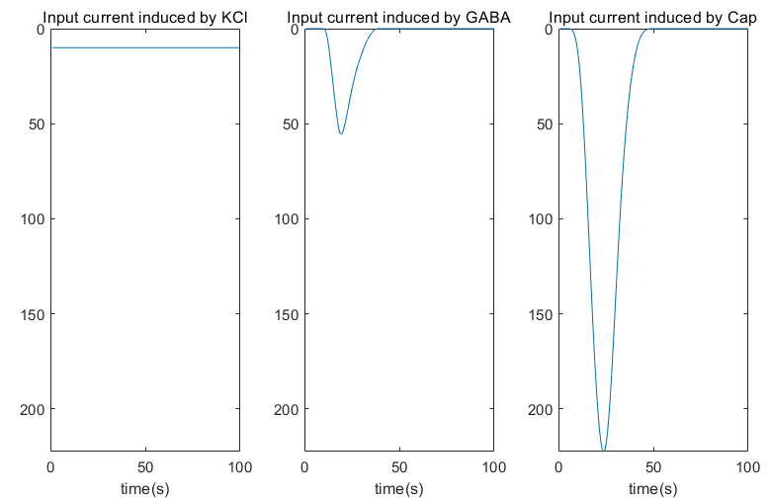
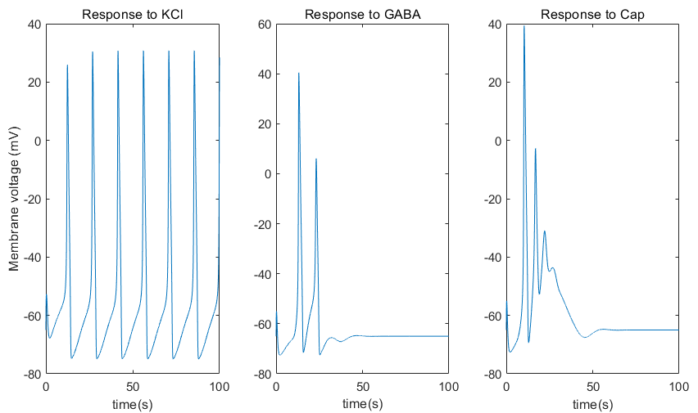
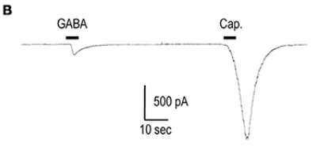
Discussion
One remaining question:
How can different chemical stimulus induce distinct temporal spiking patterns?
Biologically plausible Hodgkin-Huxley neuron model -> Computational modulation
If such neuron models fire similar to recorded data in response to known chemicals, we may use the model to explore how unknown chemical modulates human sensory system.

Slide 8



Human prediction
1 3 2 3 2 2 3 3 2 2 3 1 1 1 2
Machine prediction
1 3 2 1 2 2 3 3 2 2 1 1 1 1 2

Slide 9
Q&A

